Slide 1
Chapter 10 Dictionaries

Slide 2
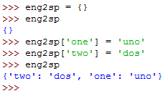


Create Dictionaries
Dictionaries are similar to other compound types except that, instead of using integers as indices, they can use any immutable type as an index.
The elements of a dictionary appear in a comma-separated list. Each entry contains an index and a value separated by a colon.
In a dictionary, the indices are called keys, so the elements are called key-value pairs.
Another way to create a dictionary is to provide a list of key-value pairs:
We use the keys to look up the corresponding values:

Slide 3
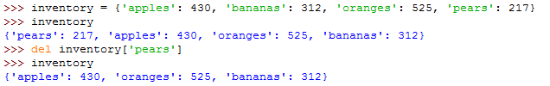


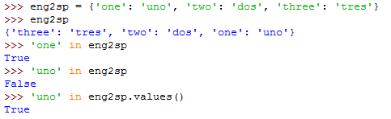
Dictionary operations
The del statement removes a key-value pair from a dictionary:
Dictionaries are mutable:
The len function can be used with dictionaries; it returns the number of key-value pairs:
The in operator works on dictionaries; it checks whether something appears as a key in the dictionary.

Slide 4




Dictionary methods
A method is similar to a function—it takes arguments and returns a value—but the syntax is different. Instead of the function syntax keys(eng2sp), we use the method syntax eng2sp.keys():
This form of dot notation specifies the name of the function, keys in this case, and the name of the object to apply the function to, eng2sp. This method returns a list of the keys in the dictionary.
The values method is similar; it returns a list of the values in the dictionary:
If a method takes an argument, it uses the same syntax as a function call:
The items method returns both, in the form of a list of tuples—one for each key-value pair:

Slide 5


Example Using Dictionary
Count how many times each letter appears in a string. Using dictionary we don’t have to know ahead of time which letters appear in the string and we only have to make room for the letters that do appear:
get is a dictionary method that takes as the first argument the key and the second argument the value it should return if the key is not in the dictionary.
We can display the letters in alphabetical order using the items and sort methods. items method returns a list which we order using the sort method.
Create a function that gets a strings and returns a sorted dictionary.

Slide 6
Chapter 11 Files

Slide 7

Reading and Writing Files
To open a file, we specify its name and indicate whether we want to read or write:
Opening a file creates a file data type. The variable f refers to this new file object.
The open function takes two arguments:
The first is the name of the file, and
the second is the mode. Mode "w" means that we are opening the file for writing.
If there is no file named test.dat, it will be created.
If there is already a file named test.dat, it will be replaced by the file we are writing.

Slide 8




Reading and Writing Files Cont.
To store data in the file we invoke the write method on the file object:
Closing the file tells the system that we are done writing and makes the file available for reading:
We can open the file again, this time for reading, and read the contents into a string. The mode argument for reading is "r" :
With no arguments, it reads the entire contents of the file.
read method can also take an argument that indicates how many characters to read:

Slide 9



Text Files
A text file is contains printable characters and whitespace, organized into lines separated by newline characters.
The readline method reads all the characters in a line up to and including the next newline character:
readlines returns all of the remaining lines as a list of strings:

Slide 10
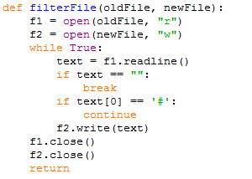
Text Files Cont.
An example of a line-processing program. filterFile makes a newFile omitting any lines that begin with # in the oldFile:
The while loop is infinite because the value True is always true.
The only way to get out of the loop is to execute break statement, which happens when text is the empty string, which happens when we get to the end of the file.
If the first character of text is a hash mark, the continue statement is executed which ends the current iteration of the loop, but continues looping and the flow of execution moves to the top of the while loop.
Only if both conditions fail do we copy text into the new file.

Slide 11


Writing Variables
The argument of write method has to be a string, so if we want to store other values in a file, we have to convert them to strings first. The easiest way to do that is with the str function:
An alternative is to use the format operator %. When applied to integers, % is the modulus operator. But when the first operand is a string, % is the format operator.
A format sequence can appear anywhere in the format string, so we can embed a value in a sentence. The letter d stands for “decimal”:
The first operand is the format string, and the second operand is a tuple of expressions. The result is a string that contains the values of the expressions, formatted according to the format string.

Slide 12
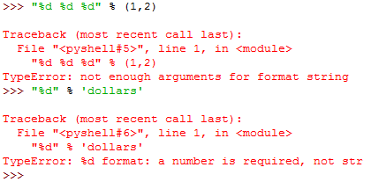

Writing Variables Cont.
The number of expressions in the tuple has to match the number of format sequences in the string. Also, the types of the expressions have to match the format sequences:
We have more control over the format of numbers. We can specify the number of digits as part of the format.
The number after the percent sign is the minimum number of spaces the number will take up.
If the value provided takes fewer digits, leading spaces are added.

Slide 13


Writing Variables Cont.
If the number of spaces is negative, trailing spaces are added:
For floating-point numbers, we can also specify the number of digits after the decimal point:

